Slide 1
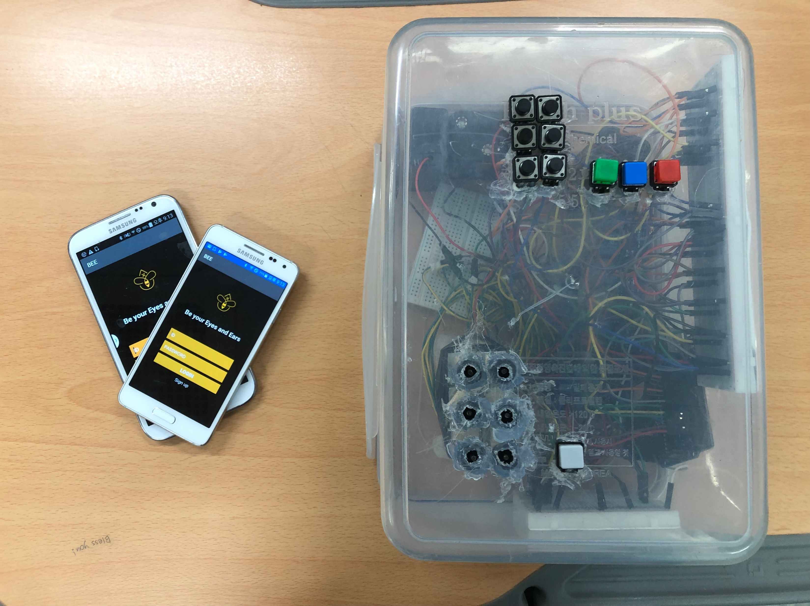
Overview

Slide 2
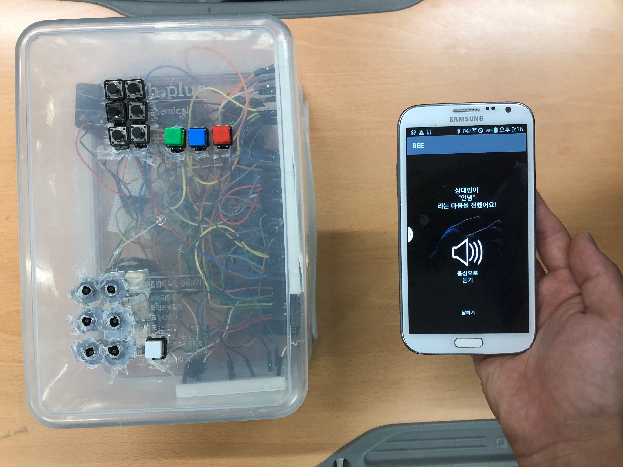
Normal-mode

Slide 3
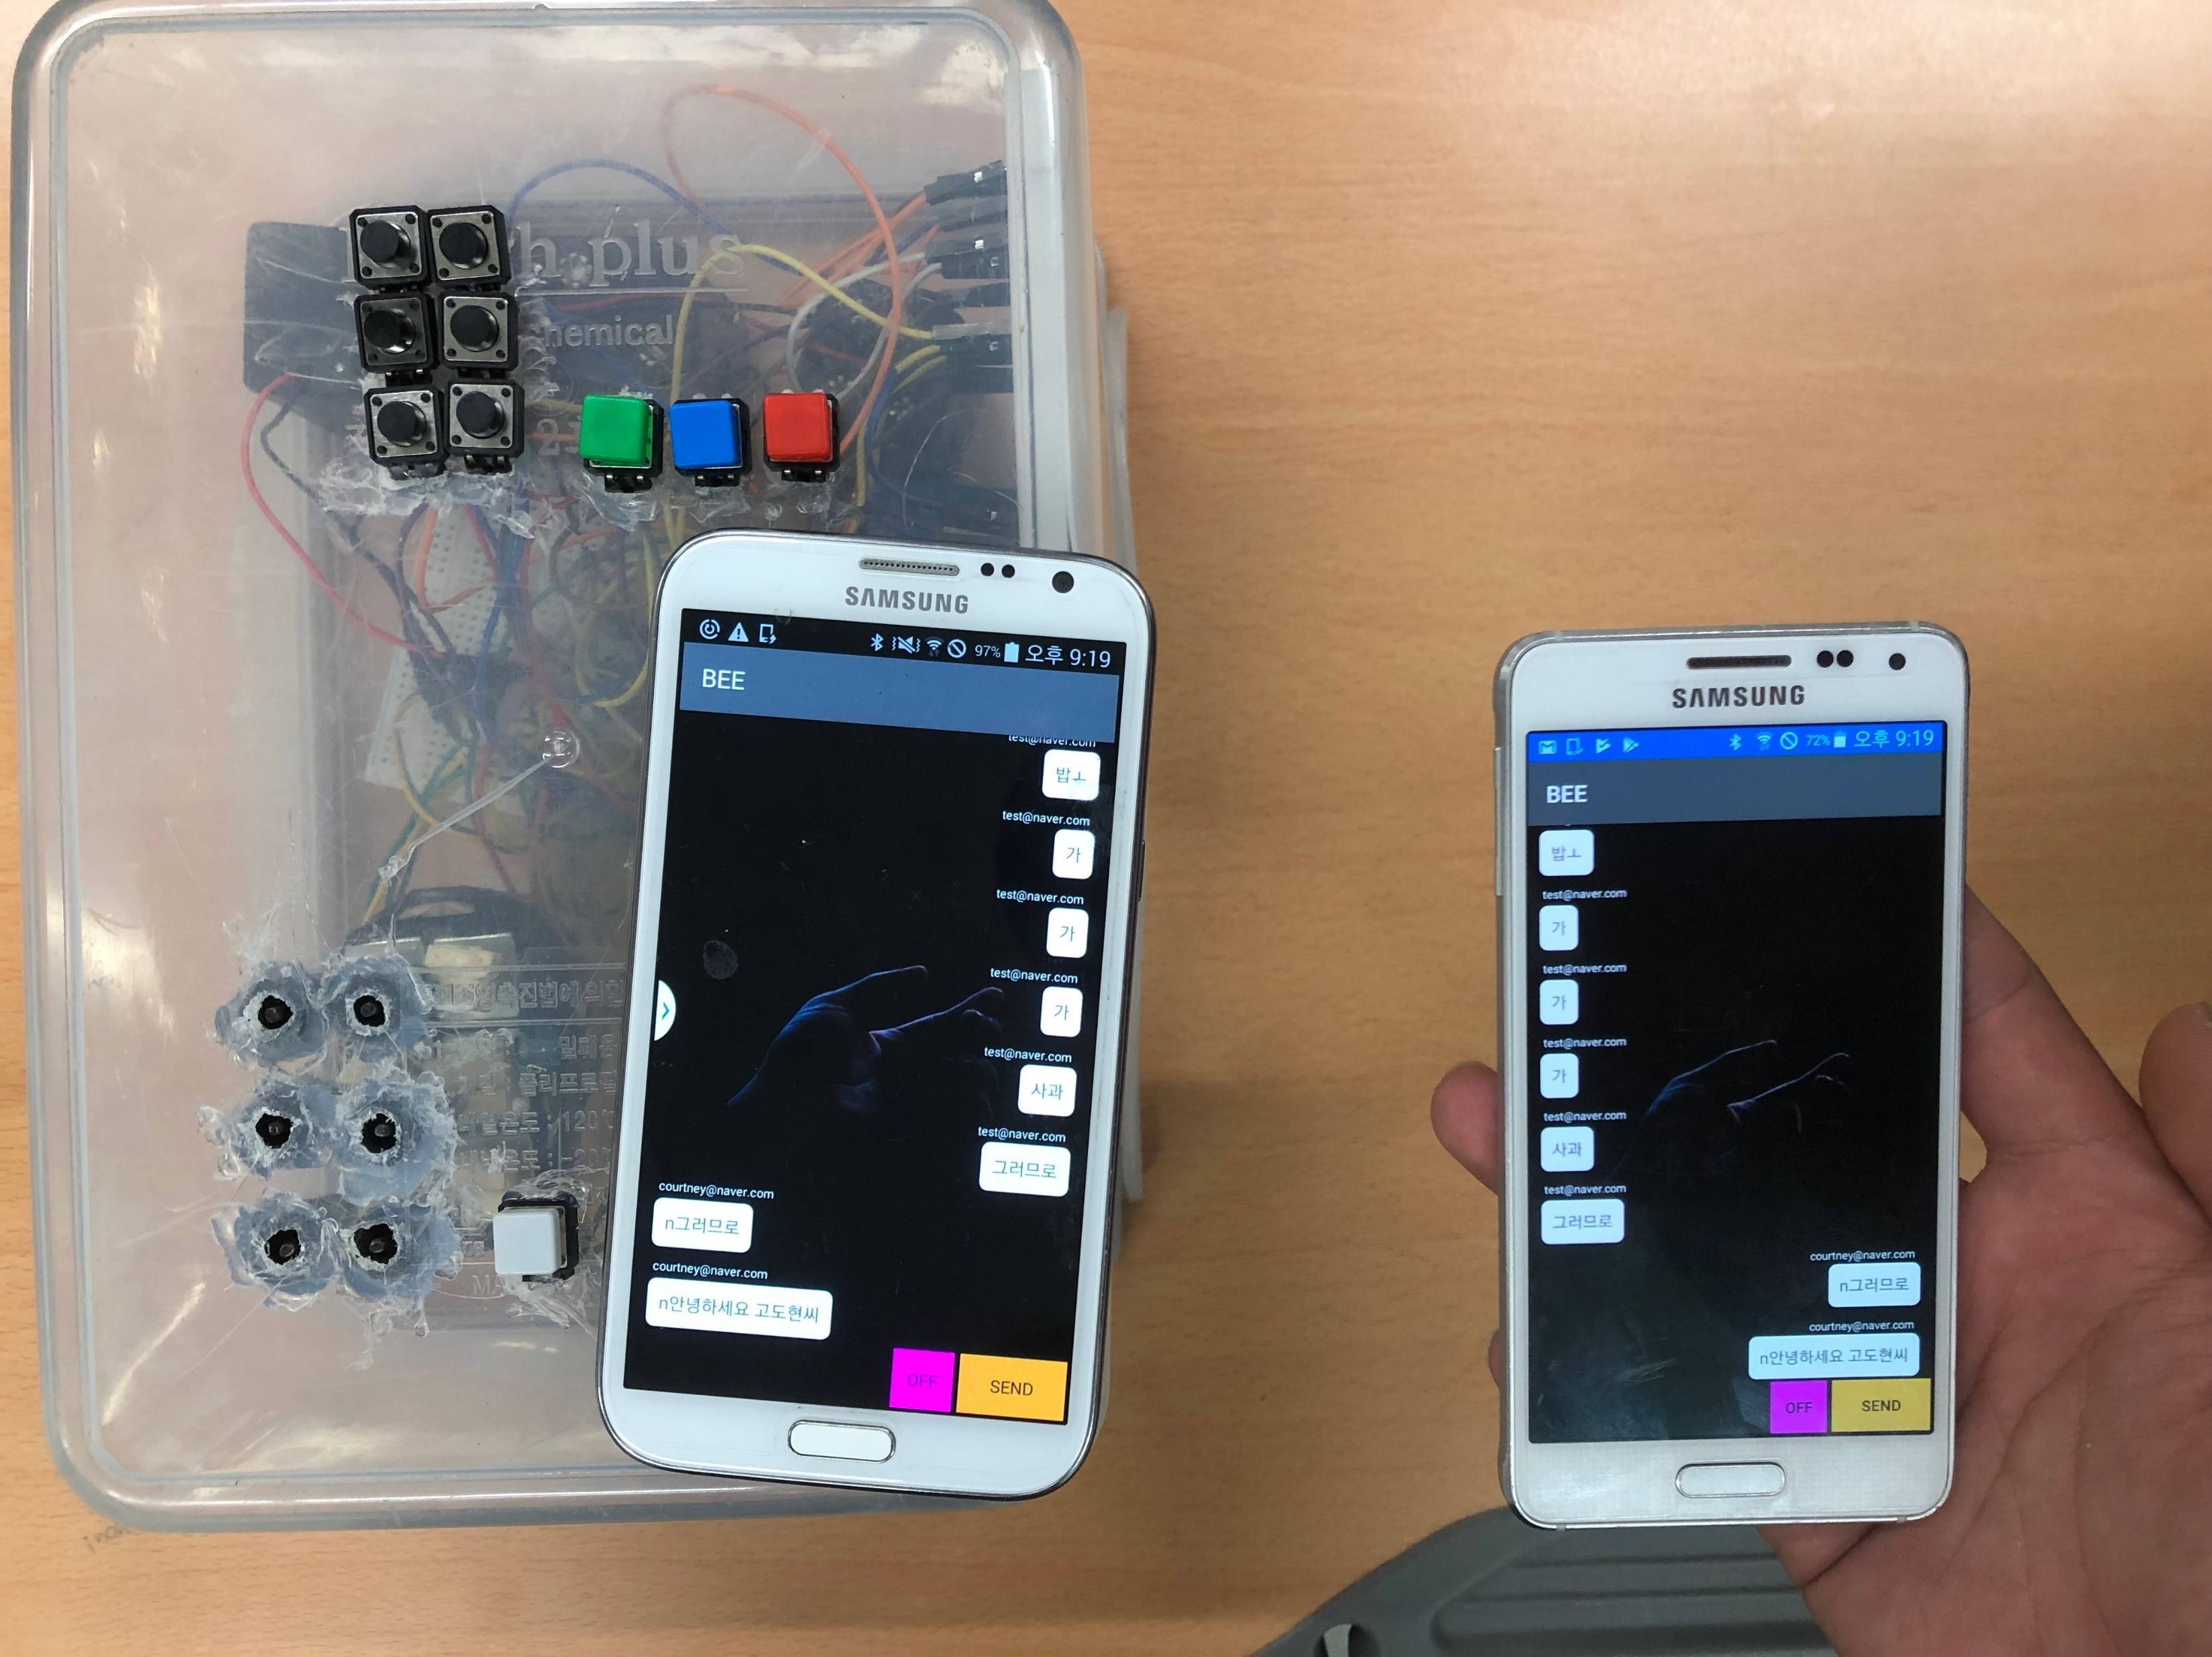
Barrier-Free mode: Realtime chat

Slide 4
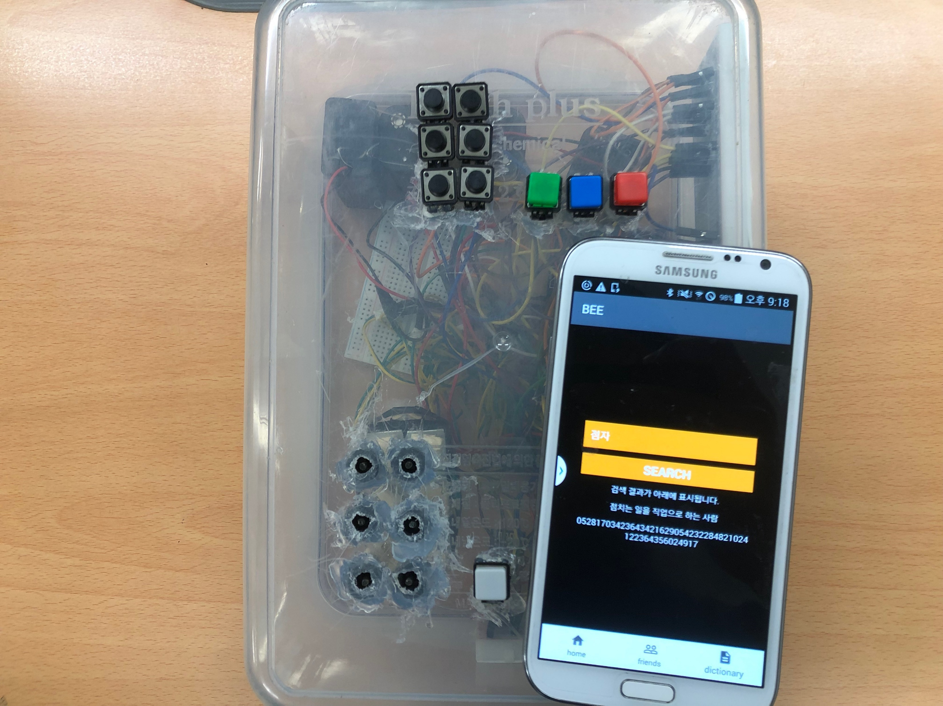
Barrier-Free mode: Dictionary

